Slide 1
Recent Advances in System Modelling and Simulation Dr. Michael Winokur and Avi Zaguri Faculty of Technology Management - HIT Feb 2021
Notes:
המצגת נועדה לתמצות הנושאים העיקריים שלמדנו וחקרנו, היא לא מחליפה את הספר ואנו יודעים כי הבוחנים קראו אותו לעומק

Slide 2
Contents
Purpose of the Reserach Test Cases Results Summary
Main Conclusions of the Research
Future Directions

Slide 3
The purpose of the Research
Comparative Research between several languages, methods and modeling tools to examine what is the most effective combination for the system engineer

Slide 4
Research questions
What is the "ideal" modeling method for systems engineering and in what layer (system or components) should it be performed?
What is more effective: A modeling tool accompanied by a known language / method that has the ability of link to the physics of the system parts within the same tool or a combination of different system modeling and drawing tools?

Slide 5
Research framework
Preliminary screening of the variety of languages / methods and modeling tools in the research
A decision of using tools and languages recognized in industry in the country
The tools and methods selected are:
Modeling tools: System Composer and Enterprise Architect
Modeling Methods/languages: ECSAM and SysML
Diagram tools: Visio
The relationships between the languages ​​/ methods of the modeling tools and the drawing tools that researched:
System Composer with ECSAM
Enterprise Architect with SysML
Visio with ECSAM

Slide 6
The indices for examining the research questions
מדדים | Research question | No.
1. Visual convenience | What is the "ideal" modeling method for systems engineering and in what layer (system or components) should it be performed? | 1
2. A modeling language is familiar to all project participants
3. Performing re-setting / updating setting
4. IN \ OUT - change inputs and outputs in the various systems
5. Architecture changes by moving elements
6. Effect of changes in the middle of the project
1. Visual convenience | What is more effective: A modeling tool accompanied by a known language / method that has the ability of link to the physics of the system parts within the same tool or a combination of different system modeling and drawing tools? | 2
2. Performing re-setting / updating setting
3. IN \ OUT - change inputs and outputs in the various systems
4. Architecture changes by moving elements
5. Effect of changes in the middle of the project
1. Visual convenience | To which extent is there an advantage to modeling tools over using Visio drawings? | 3
2. Performing re-setting / updating setting
3. IN \ OUT - change inputs and outputs in the various systems
4. Architecture changes by moving elements
5. Effect of changes in the middle of the project
The simulation was tested only in the System Composer tool

Slide 7
Test Cases

Slide 8
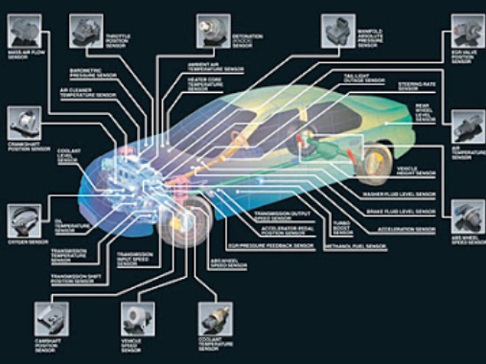

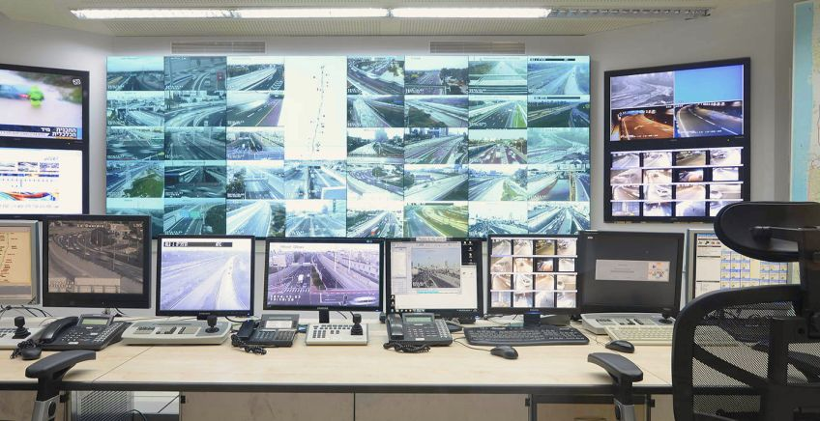
"360-degree Car Damage Monitoring"
"360-degree car damage monitoring" - a high-complexity integrated system with sub-systems with medium / high complexity

Slide 9
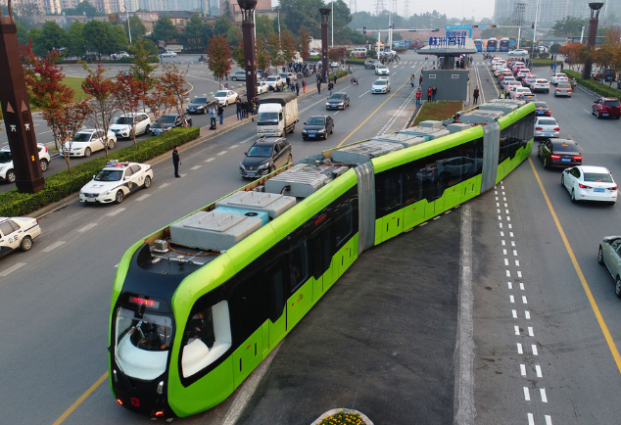
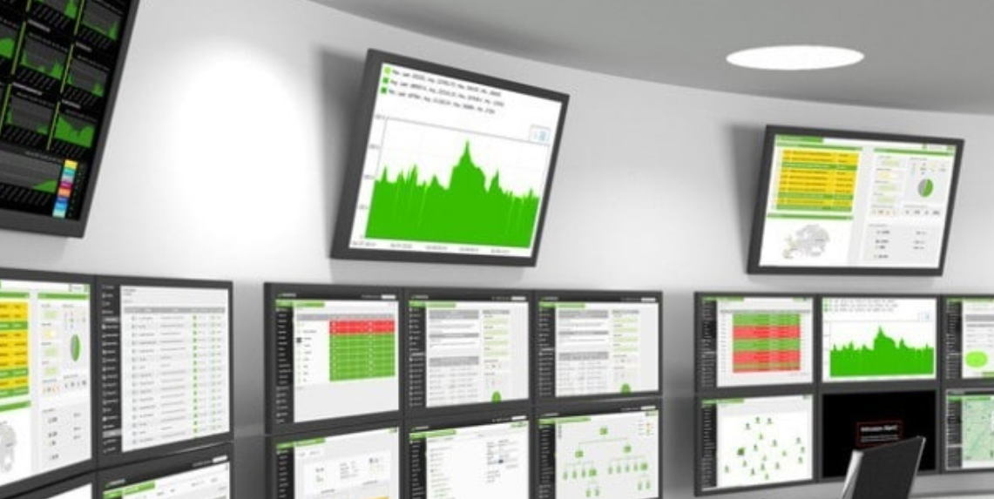
"Smart train carriages management"
"Smart train carriages management" - an integrated system with medium / high complexity with many identical subsystems with low complexity

Slide 10
Indicators for examining research questions
Weights | Indicators
20% | Visual convenience
20% | Performing re-setting / updating setting
10% | IN \ OUT - change inputs and outputs in the various systems
10% | Architecture changes by moving elements
10% | A modeling language is familiar to all project participants
30% | Effect of changes in the middle of the project

Slide 11
Results Summary

Slide 12
Advantages and disadvantages - System Composer + ECSAM
Advantages
Clear visual display
Switch in a simple and immediate way between the various components
Add and remove components easily and quickly
A simple link between the various components
Receive data on each link (parameters, protocol, inheritances if any, etc.)
Linking the requirements documents / parts of the document to each component in the system
Perform simulations in a simple way while receiving data on each and every step
Duplicate large and complex elements
Ability to share the project in a simple way
Disadvantages
Changing architecture can be very complicated
Unable to produce a summary/report document for all/part of system components
Inconvenient WEB interface for sharing project architecture to a user without MATLAB

Slide 13
Advantages and disadvantage - Enterprise Architect + SysML
Advantages
Clear visual display
Move easily between the different levels
Work in an orderly hierarchical manner (according to the SysML language)
Add and remove components easily and quickly
A simple link between the various elements
A recurring element is required in construction only once
Disadvantage
A major change after modeling the overall architecture can be complex
A change in IBD of an individual block does not affect the overall IBD
Inability to perform modeling on a physical level

Slide 14
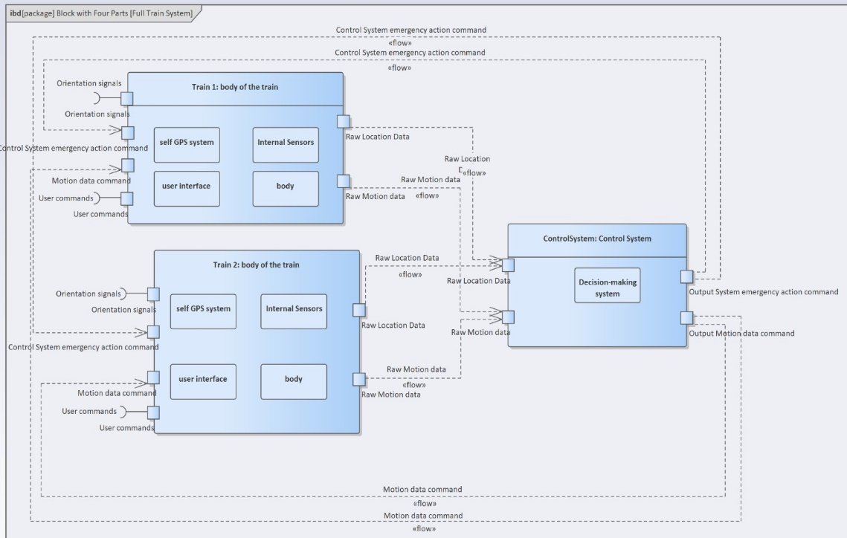
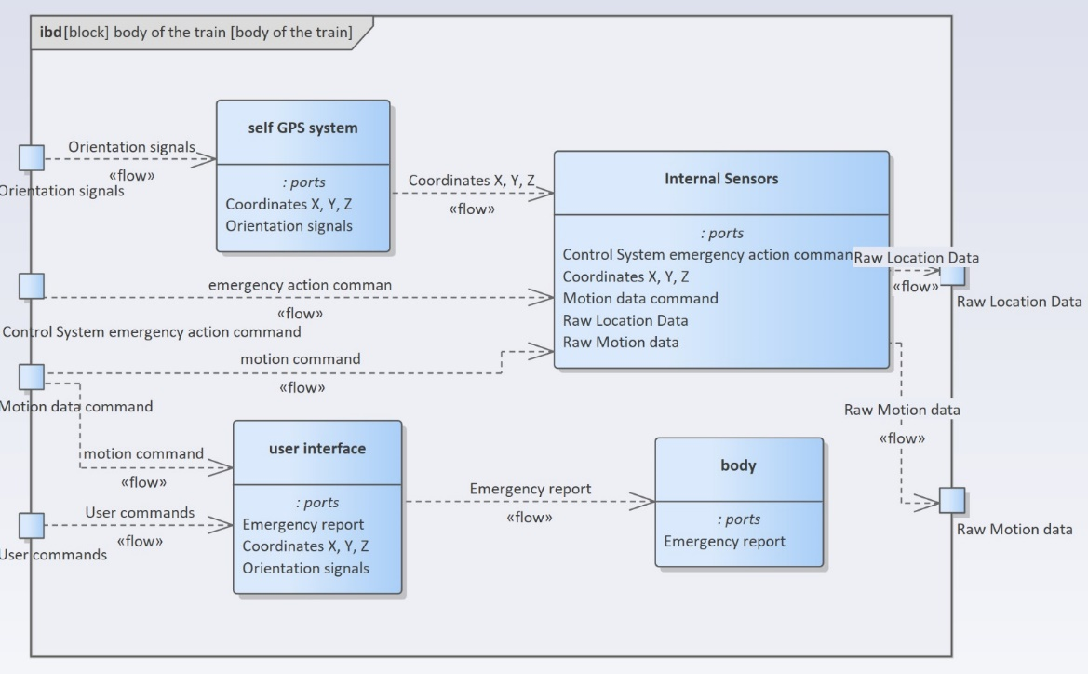
Example - Enterprise Architect + SysML
From the Enterprise Architect tool - "Smart train carriages management"
(General IBD of the System)
From Enterprise Architect tool - "360-degree Car Damage Monitoring“
(Private IBD of the System)

Slide 15
Advantages and disadvantages – VISIO + ECSAM
Advantages
Diagramming software market leader
Has a wide variety of diagram shapes
Most professionals are familiar with the software and how to use it
Add and remove components easily and quickly
Simply link between the various components
Duplicate large and complex elements
Ability to share the project in a simple way without download / buy the software
Inconvenient WEB interface for sharing project architecture to a user without Visio
Disadvantages
Building the model takes a long time to design it to a readable and clear level
Can change several times, due to unreadable construction
Changing architecture can be very complicated
No ability to receive data on each link (parameters, protocol, etc.)
The data on each link must be written in a static-regular manner
There is no ability to link documents to the various diagrams in the system
There is no ability to perform simulations and as a result there are no analysis capabilities

Slide 16
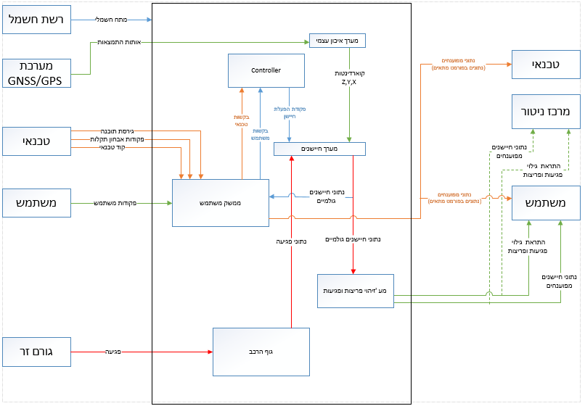
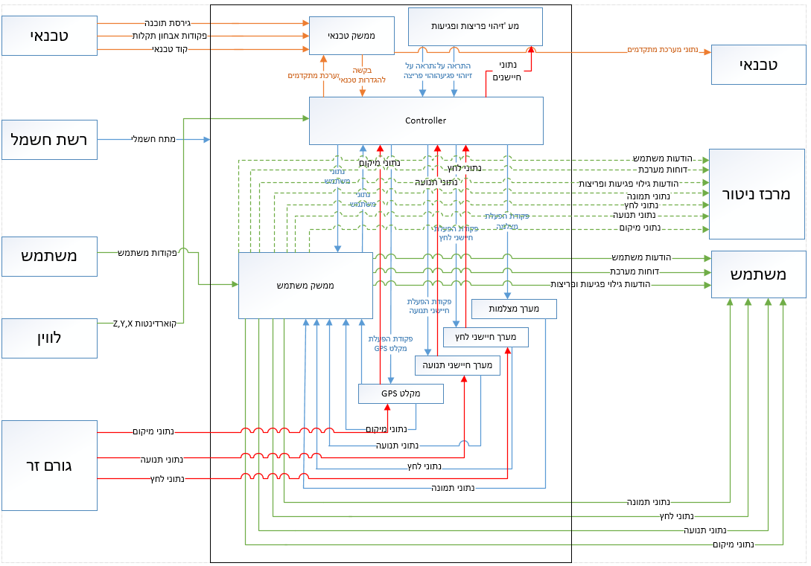
Example - VISIO
From the Visio drawing tool - "360-degree Car Damage Monitoring"
Drawing after experimenting with System Composer
From the Visio drawing tool - "360-degree Car Damage Monitoring"
Drawing before experimenting with System Composer

Slide 17
Summary of research results
כלי ושיטה | תוצאת סיכום מדדים משוקלל
System Composer + ECSAM | 9
Enterprise Architect + SysML | 7.5
Visio + ECSAM | 5.3

Slide 18
Simulation Capabilities

Slide 19
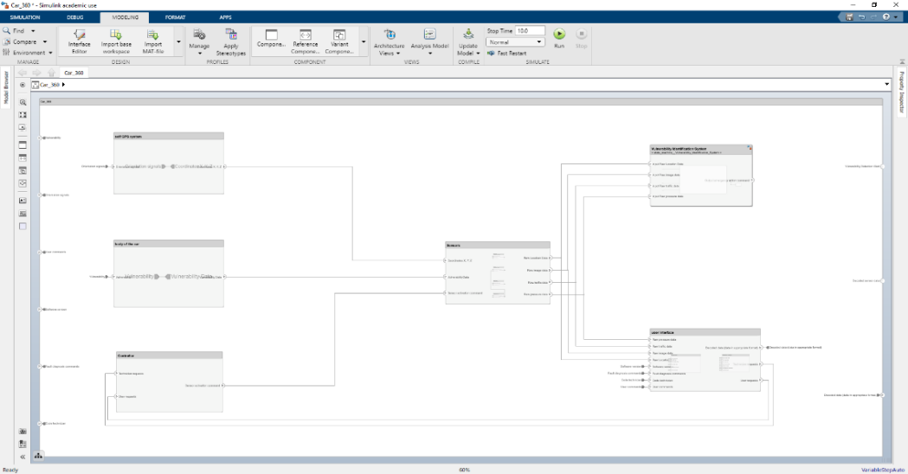
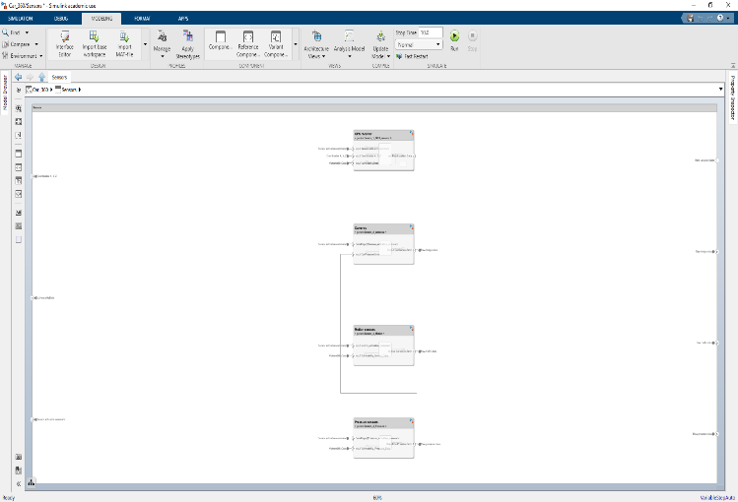
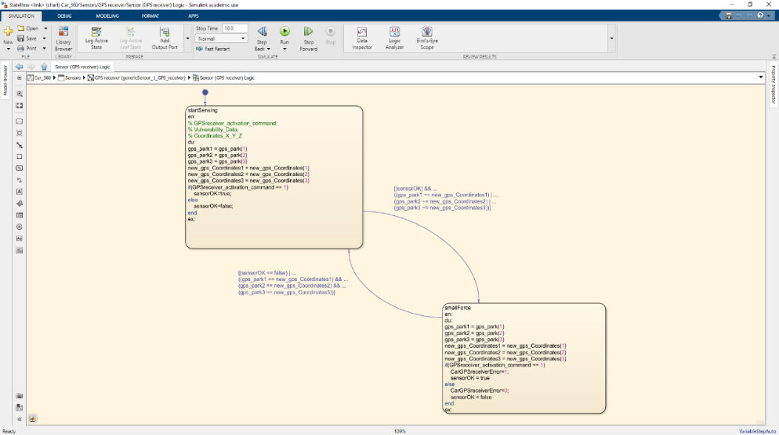
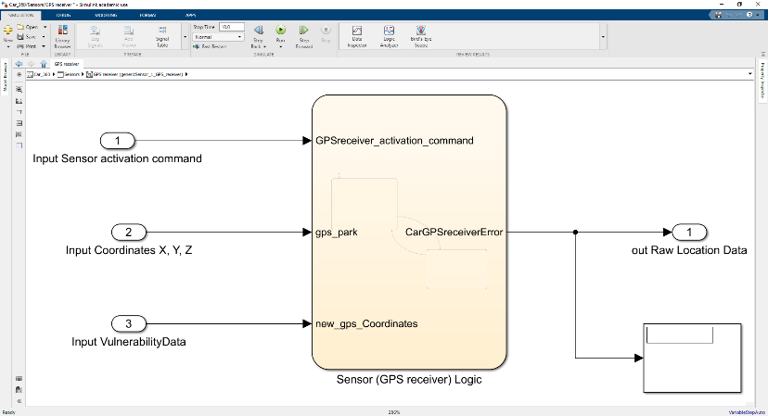
Design validation by simulation (1/2)
A decrease in the resolution of the layers to the level of the component itself (sensors)
Complex simulation capabilities, with capabilities for analyzing, building models, and running simulations in a simple way
Performing simulations at the individual component level and the overall system level
Finding faults and saving a lot of resources

Slide 20
Design validation by simulation (2/2)
Description of the Scenario Trial |  | Example of a Scenario: Accident damage to the body of the car
The pressure sensors detected a blow to the car body at 30k psi, The pressure sensors detected the blow that was below the low threshold. Due to the debilitating damage, the camera sensors were not activated and no alert was sent to the control center. | Trial 1
The pressure sensors detected a blow to the car body at 40k psi, The pressure sensors detected the blow that was above the low threshold, but below the high threshold, due to the moderate impact the camera sensors were not activated and an alert was sent to the control center. | Trial 2
The pressure sensors detected a blow to the car body at 130k psi, The pressure sensors detected the blow that was above the high threshold, due to the strong impact the camera sensors were activated and an alert was sent to the control center. | Trial 3

Slide 21
Main Conclusions of the Research
There was no need for a special tool use course
The use of modeling tools makes it possible to reduce the investment time in "free drawings"
Working with a single modeling tool that includes all aspects of the use phase enables overall system modeling as well as detailed components modeling and integration
The objective to perform systemic simulations, as comprehensive as possible, as early as possible in the project, using automation is close at hand
There is a great chance of assimilation in industry in complex projects - further research is planned and collaboration with industry

Slide 22
Future Directions
Continuation of current research in collaboration with industry
Linking the systemic layer to the physical modeling of the components
Automation of system simulation and report generation
Use of tools from the world of "OPEN SOURCE" for the initial concept phase
Examining the continuation and deepening of the research within the framework of a third degree
Further research in industrial modeling, analysis and system simulation using SysML v2
Using of tools as standard in HIT systems engineering courses (starting 2020-21 academic year)
Option to use tools and examples in IoT and CIM courses

Slide 23
Questions ?

Slide 24
Thanks !

